Slide 1
INTRODUCTION TO THE PERSONAL COMPUTER
Chapter 1

Slide 2

Objective
1.1 Personal Computer Systems
1.2 Select Computer Components
1.3 Configurations for Specialized Computer Systems

Slide 3
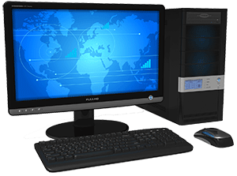
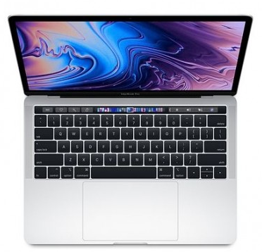
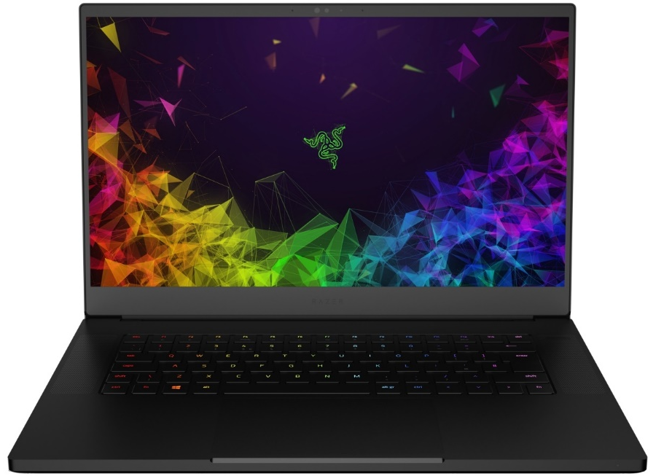
1.1 Personal Computer Systems
A Personal Computer (PC) is a multi-purpose computer whose size, capabilities, and price make it feasible for individual use.
Personal computers are intended to be operated directly by an end user, rather than by a computer expert or technician

Slide 4
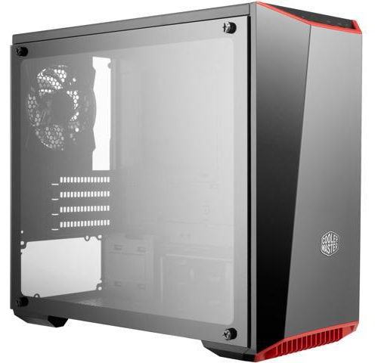
1.1.1 Cases and Power Supplies
Cases
A computer case, also known as a computer chassis, tower, system unit, or cabinet, is the enclosure that contains most of the components of a personal computer. Cases are usually constructed from steel or aluminum
• Influences the motherboard form factor choice
• Must allow for good air flow
• Available in different sizes

Slide 5
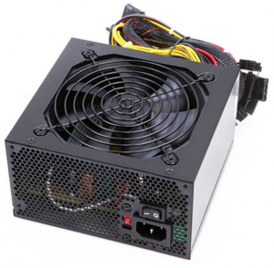
Power Supplies
A power supply unit (or PSU) converts mains AC to low-voltage regulated DC power for the internal components of a computer.
• Provides power to all computer components.
• Must be chosen based on current and future needs.
• Deliver different voltage levels to meet different internal component needs.
Power Supply Wattage
• P = V x A
-P: Power (Watts)
-V: Voltage(volts)
-A: Ampere(A)
Notes:
AC = Main Electricity to home, Alternating current (AC) is an electric current which periodically reverses direction
Direct current (DC) is the unidirectional flow of an electric charge

Slide 6
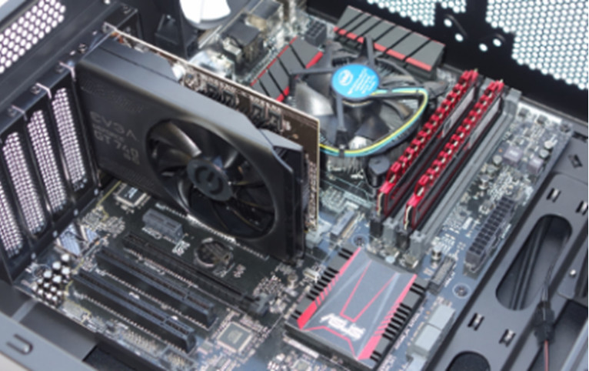
1.1.2 Internal PC Components
Internal is a term used to describe a device that is installed in the computer (CPU, RAM, VGA, SSD,…)

Slide 7
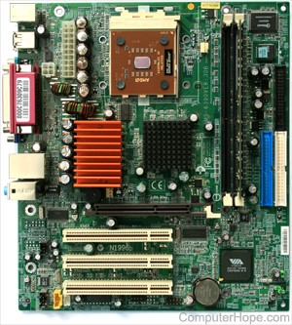
Motherboards
mainboard, base board, main circuit board, system board, or a logic board on Apple computers.
The motherboard is a printed circuit board and foundation of a computer that is the biggest board in a computer chassis. It allocates power and allows communication to and between the CPU, RAM, and all other computer hardware components.
• Backbone of the computer
• Interconnects computer components

Slide 8
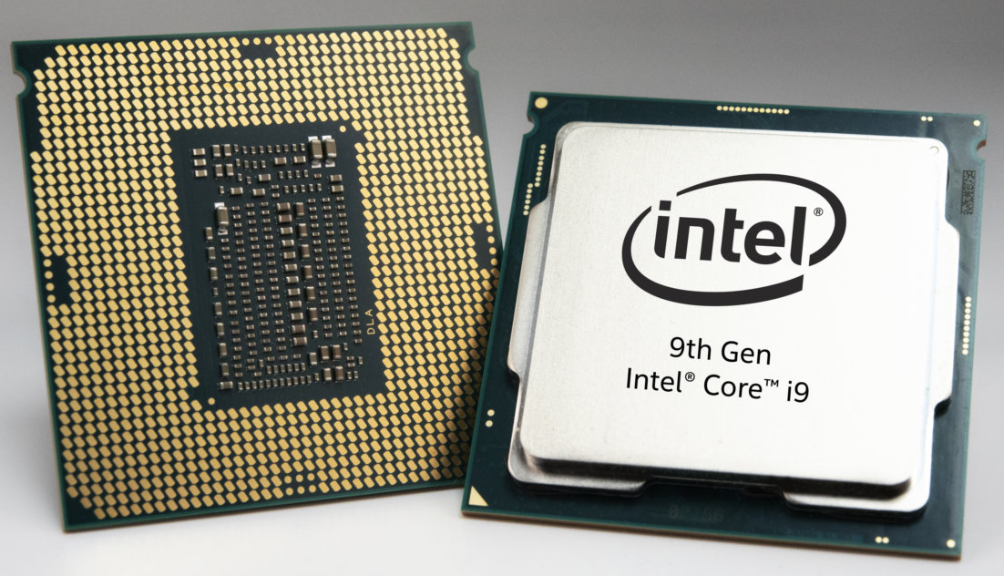
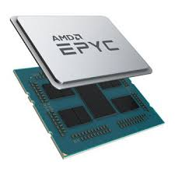
CPU
Refer as processor, central processor, or microprocessor, the CPU is the central processing unit of the computer. A computer's CPU handles all instructions it receives from hardware and software running on the computer.
• The brain of the computer
• Most processing is done by the CPU
Notes:
https://www.computerhope.com/jargon/c/cpu.htm

Slide 9
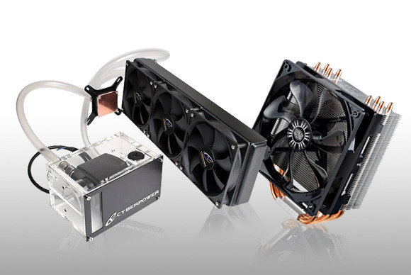
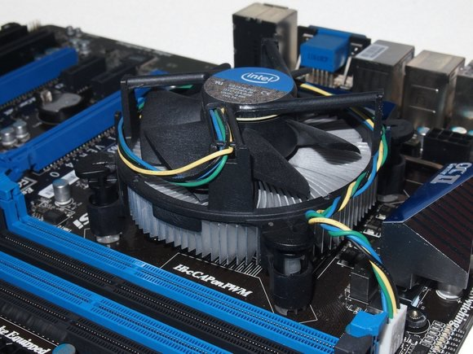
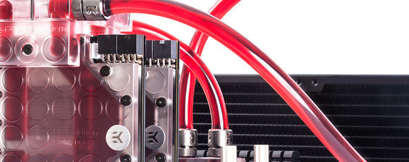
Cooling Systems
To keep your processor temperatures down and the noise levels low
air cooling
Liquid cooling
Notes:
https://www.computerhope.com/jargon/c/cpu.htm

Slide 10
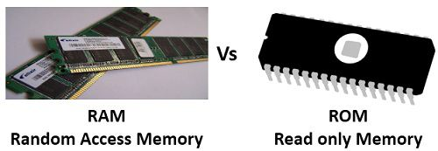
Memory (ROM and RAM)
• RAM: Stores data temporarily, aiding processing
• ROM: Stores data permanently; often storing firmware and low level programs.
Notes:
https://www.computerhope.com/jargon/c/cpu.htm

Slide 11
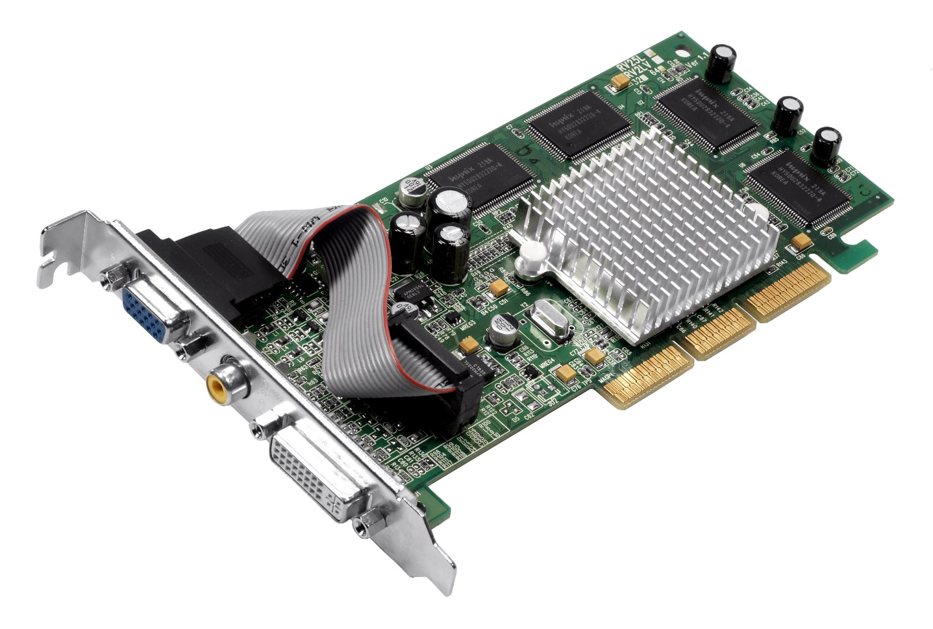
Adapter Cards and Expansion Slots
• Adapter Cards extend computer functionality
• Adapter Cards connect to the motherboard through Expansion Slots
VGA Card
Expansion port, an expansion slot is a connection or port located inside a computer on the motherboard. It provides an installation point for a hardware expansion card to be connected.
Notes:
https://www.computerhope.com/jargon/c/cpu.htm

Slide 12
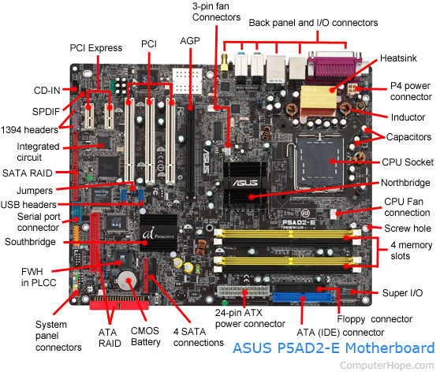

Slide 13
AGP - Video card.
AMR - Modem, sound card.
CNR - Modem, network card, sound card.
EISA - SCSI, network card, video card.
ISA - Network card, sound card, video card.
PCI - Network card, SCSI, sound card, video card.
PCI Express - Video card, modem, sound card, network card.
VESA - Video card.

Slide 14
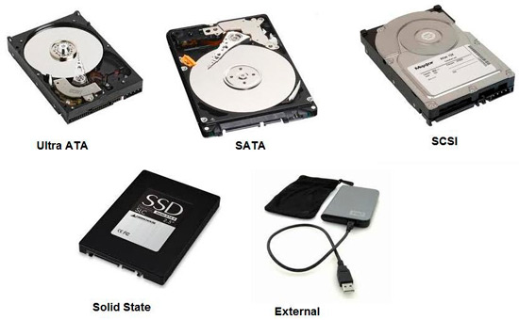
Storage Devices
Designed to permanently store user data, user applications and the Operating System
Can be internal or external to the computer

Slide 15
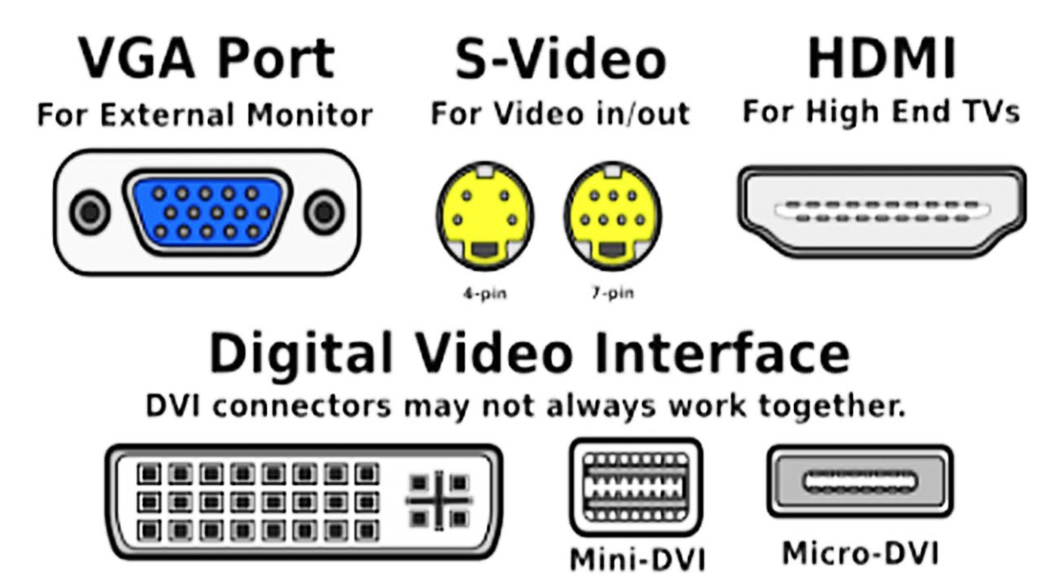
Video Ports
Connects a video system to an external display device such as a monitor or projector
Video systems are often designed as an adapter card.

Slide 16
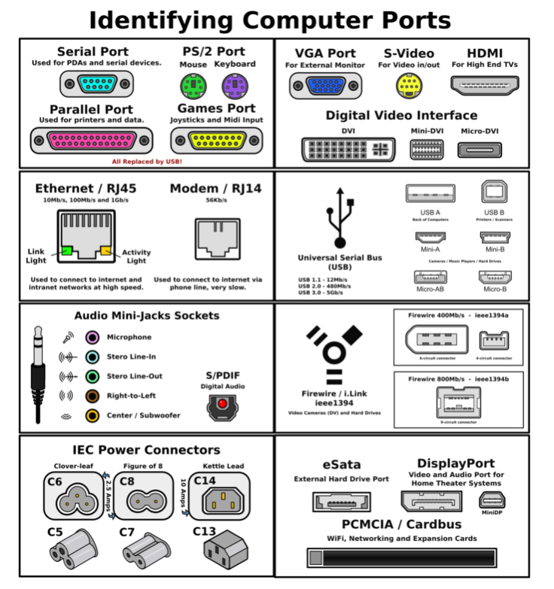
General Ports
Provide connectivity between the motherboard and various external devices such as printers, external storage and video cameras.

Slide 17
1.1.3 External Ports and Cables
Video Ports and Related Cables
• A few different standards govern video traffic between the computer and external video devices.
• HDMI and displayPort are examples of video ports that require a specific cable to operate.
Adapters and Converters
• Adapters and converters can be a solution if a motherboard does not have the proper port to connect to a device.
• Adapters do not usually process the signal; they simply redirect it to another pin.

Slide 18
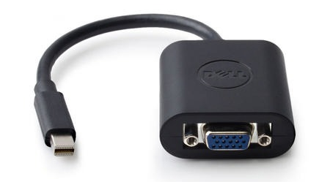
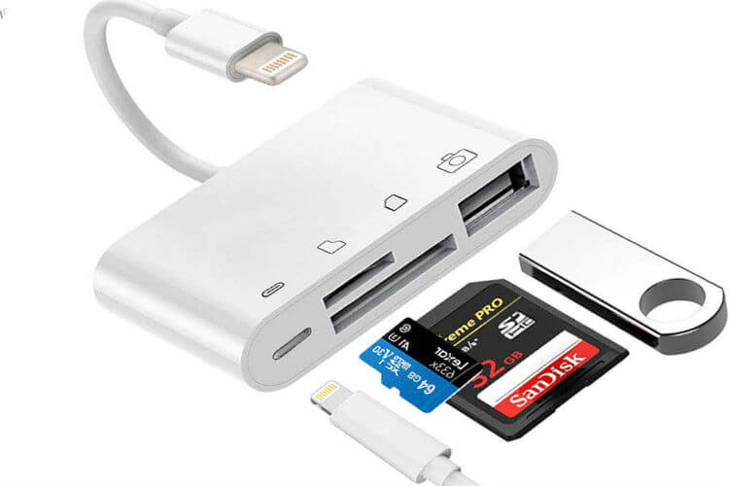
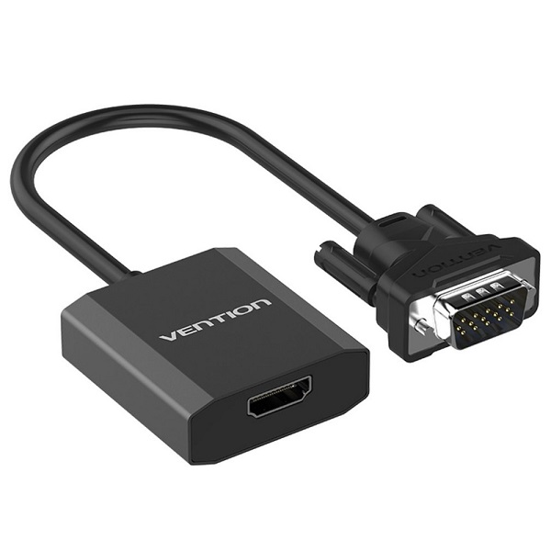
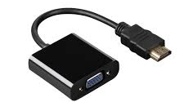
• Converters are more likely to process and transform the signal, converting it to be accepted by an existing port.
Mini Display to VGA converter
Adapters
HDMI to VGA converter
VGA to HDMI converter

Slide 19
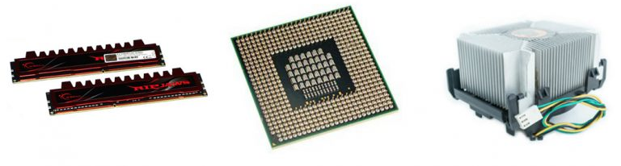
1.2 Select Computer Components
Select the Motherboard, CPU, Case and Memory
• CPU, memory, motherboard and case choices are inter-related.
• The motherboard should support all customer required applications and still fit properly in the case.
• The case should host the motherboard, the proper power supply and provide good airflow for the internal components.

Slide 20
• The CPU must be compatible with motherboard CPU slot and voltage; it should be compatible with the chosen memory speed for maximum performance.
• The memory must also be compatible with motherboard memory slots and voltage.
• The amount of memory will depend on the type of applications requested by the customer.
Select the Case and Fans
Case and fans must be chosen to maximize internal airflow.
Select the Power Supply
The power supply should be selected based on the maximum amount of power required by all the internal components.

Slide 21
Select Adapter Cards
Make sure the motherboard has compatible expansion slots to support the adapter cards.
The motherboard must also have enough expansion slots to receive all the required adapter cards.
Select Hard Drives
Important hard drive factors to be considered are speed, storage space and communication interface type.
The drive’s underlying technology (HDD vs SSD) directly impacts speed.
Select Optical Drives (CD, DVD drive)

Slide 22
Select External Storage
Important factors are storage space, speed and communication interface.
Make sure the computer has enough ports to accommodate the external devices and peripherals.
Select a Media Reader
Like Memory slot reader
Select I/O Devices
The selection of I/O devices is application specific and will depend on customer requirements.

Slide 23
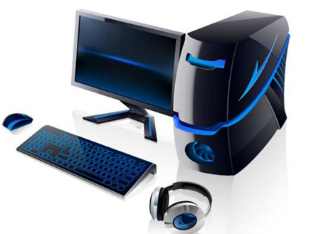
1.3 Configurations for Specialized Computer Systems
Specialized computer systems handle specific tasks,…such as point of sale systems, ATMs, and GPS. Like smartphone, tablets,…
Thick and Thin Clients
Thin clients have little processing power and are designed to act as a terminal to a server (thick client).
Thick clients have more powerful CPUs, more memory and their own storage. They serve as processing stations for thin clients.

Slide 24
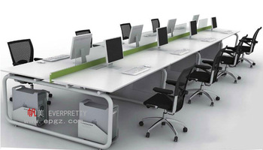
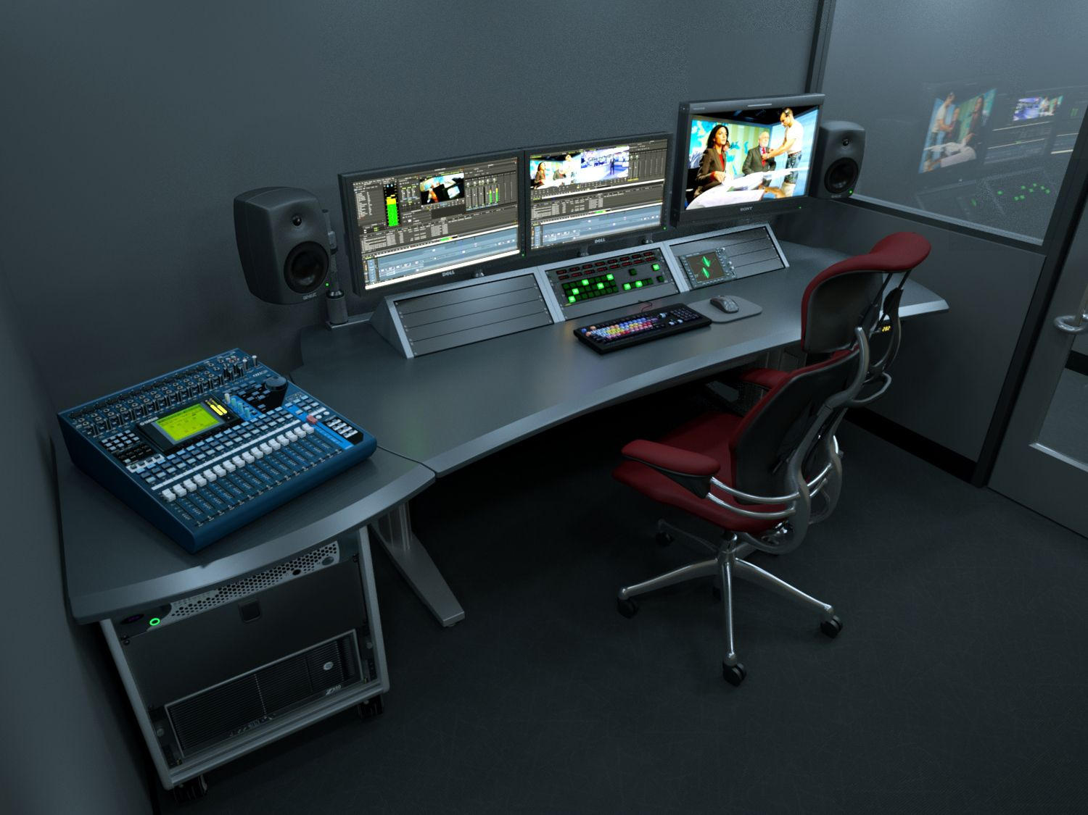
CAx Workstations
• Designed to support CAD and CAM applications.
• Plenty of RAM, fast disks, powerful CPU and special input devices are common resources.
Audio and Video Editing Workstations
• Common editing workstation resources include much RAM, fast disks, powerful CPU and special adapter cards such as audio and video capture.

Slide 25
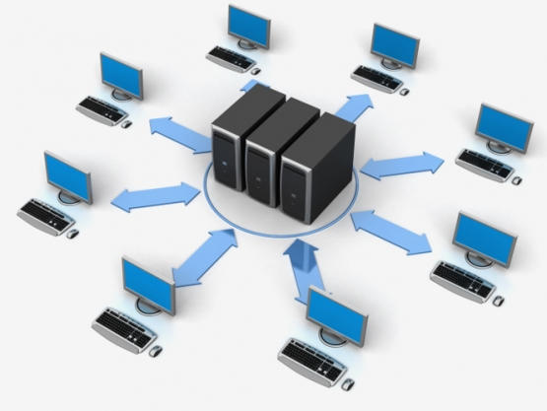
Virtualization Workstations
• These workstations are designed to run virtual computers.
• Virtual computers use and share the workstation’s physical resources such as CPU, memory and disks.
• The selection of physical resources will depend on the number and purpose of the virtual machines.

Slide 26
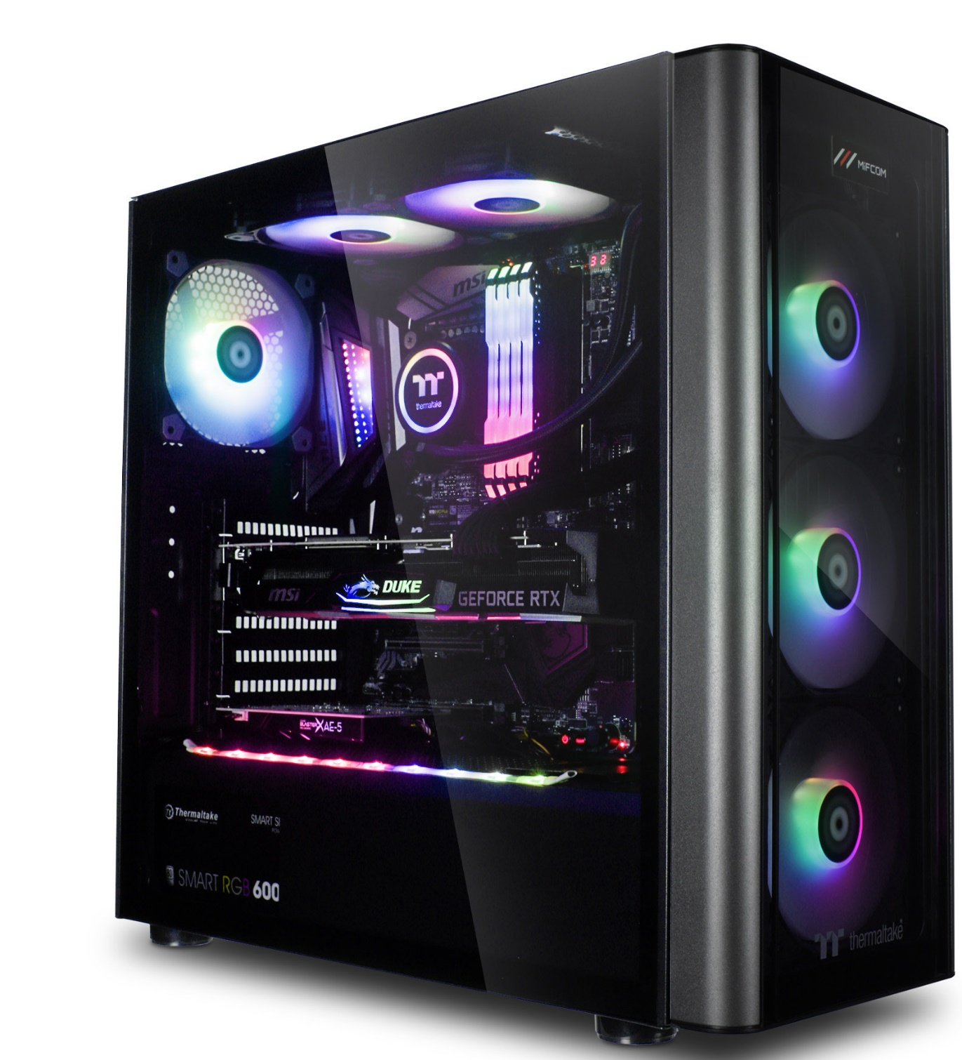
Gaming PCs
• Due to high resource requirements of modern games, gaming PCs are very resource demanding.
• A few requirements of gaming PCs are: top end CPU, lots of fast RAM, fast disks, Graphic, high performance input devices and audio systems.

Slide 27
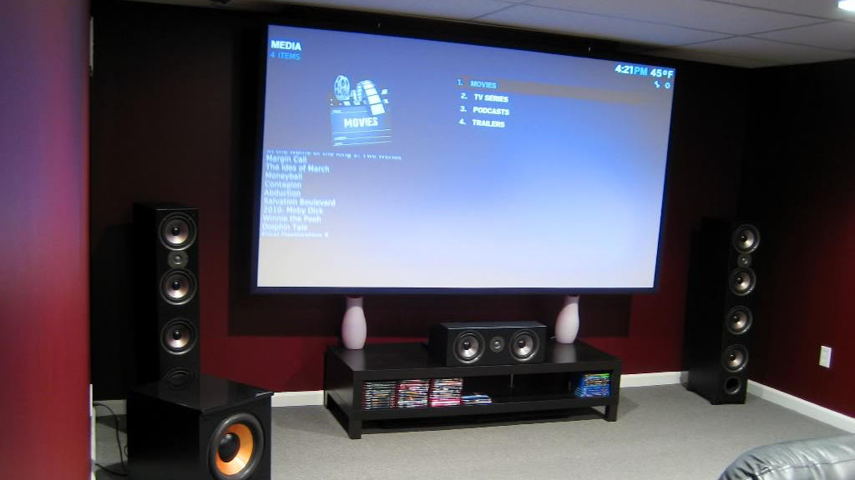
Home Theatre PCs
• These computers must be able to play various media formats and, in some cases, receive TV signals.
• Common HTPC requirements include powerful CPU, fast RAM, large disks, fast NIC and video card with TV input.

